Slide 1
Important Provisions on Legal Services Authorities
Dr. Kalpeshkumar L Gupta
Assistant Professor - Research
kgupta@gnlu.ac.in
April 9, 2019

Slide 2
Outline
1. Legal Services Authorities Act, 1987
2. Other Rules & Regulations

Slide 3
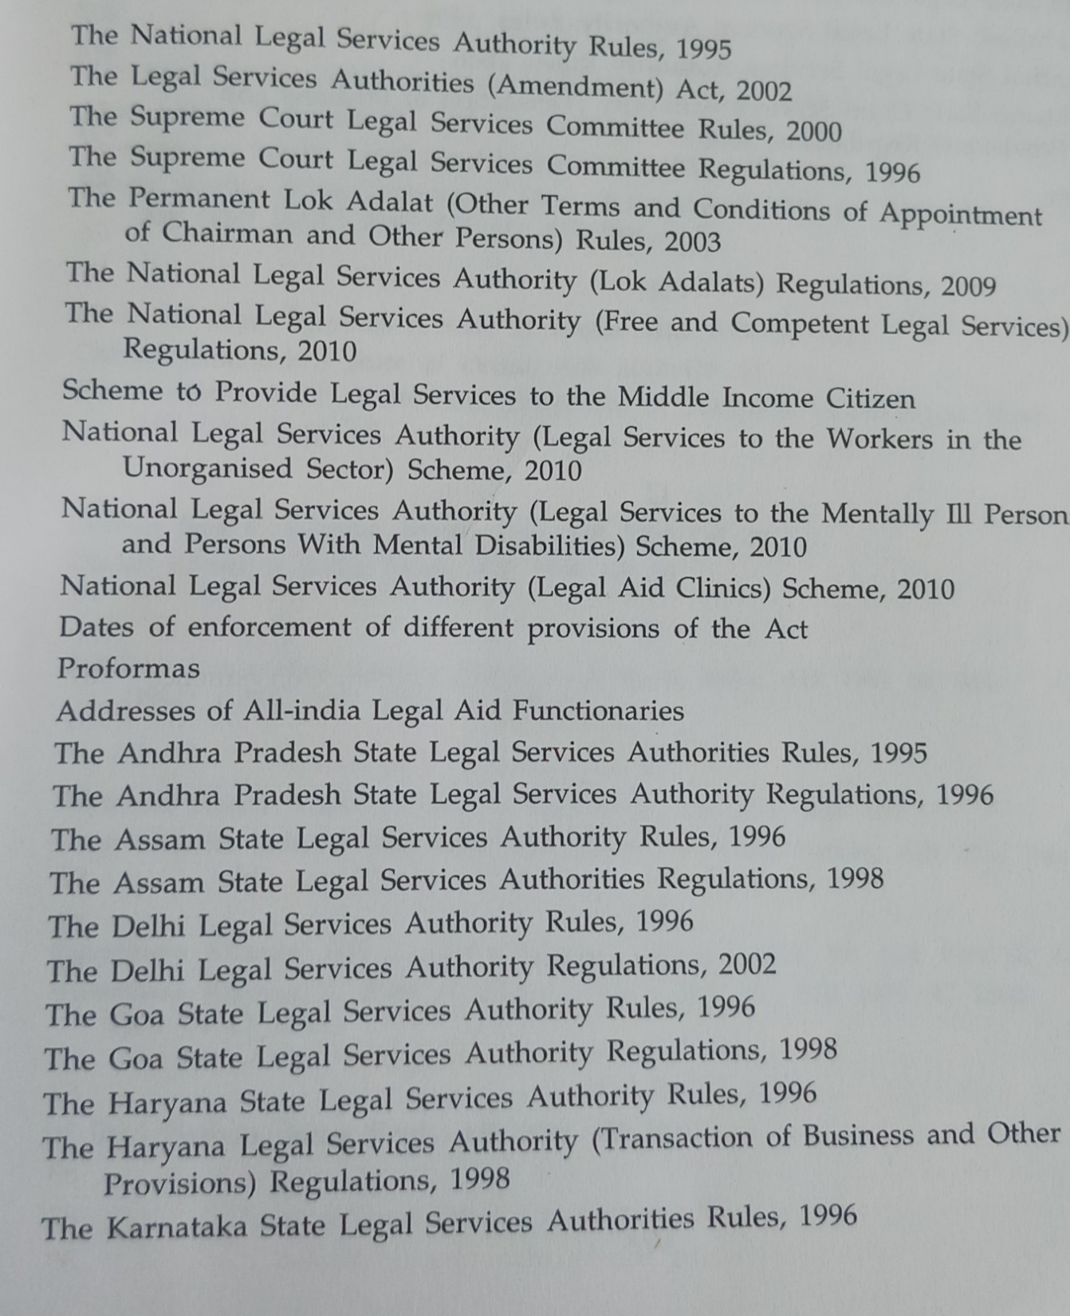

Slide 4
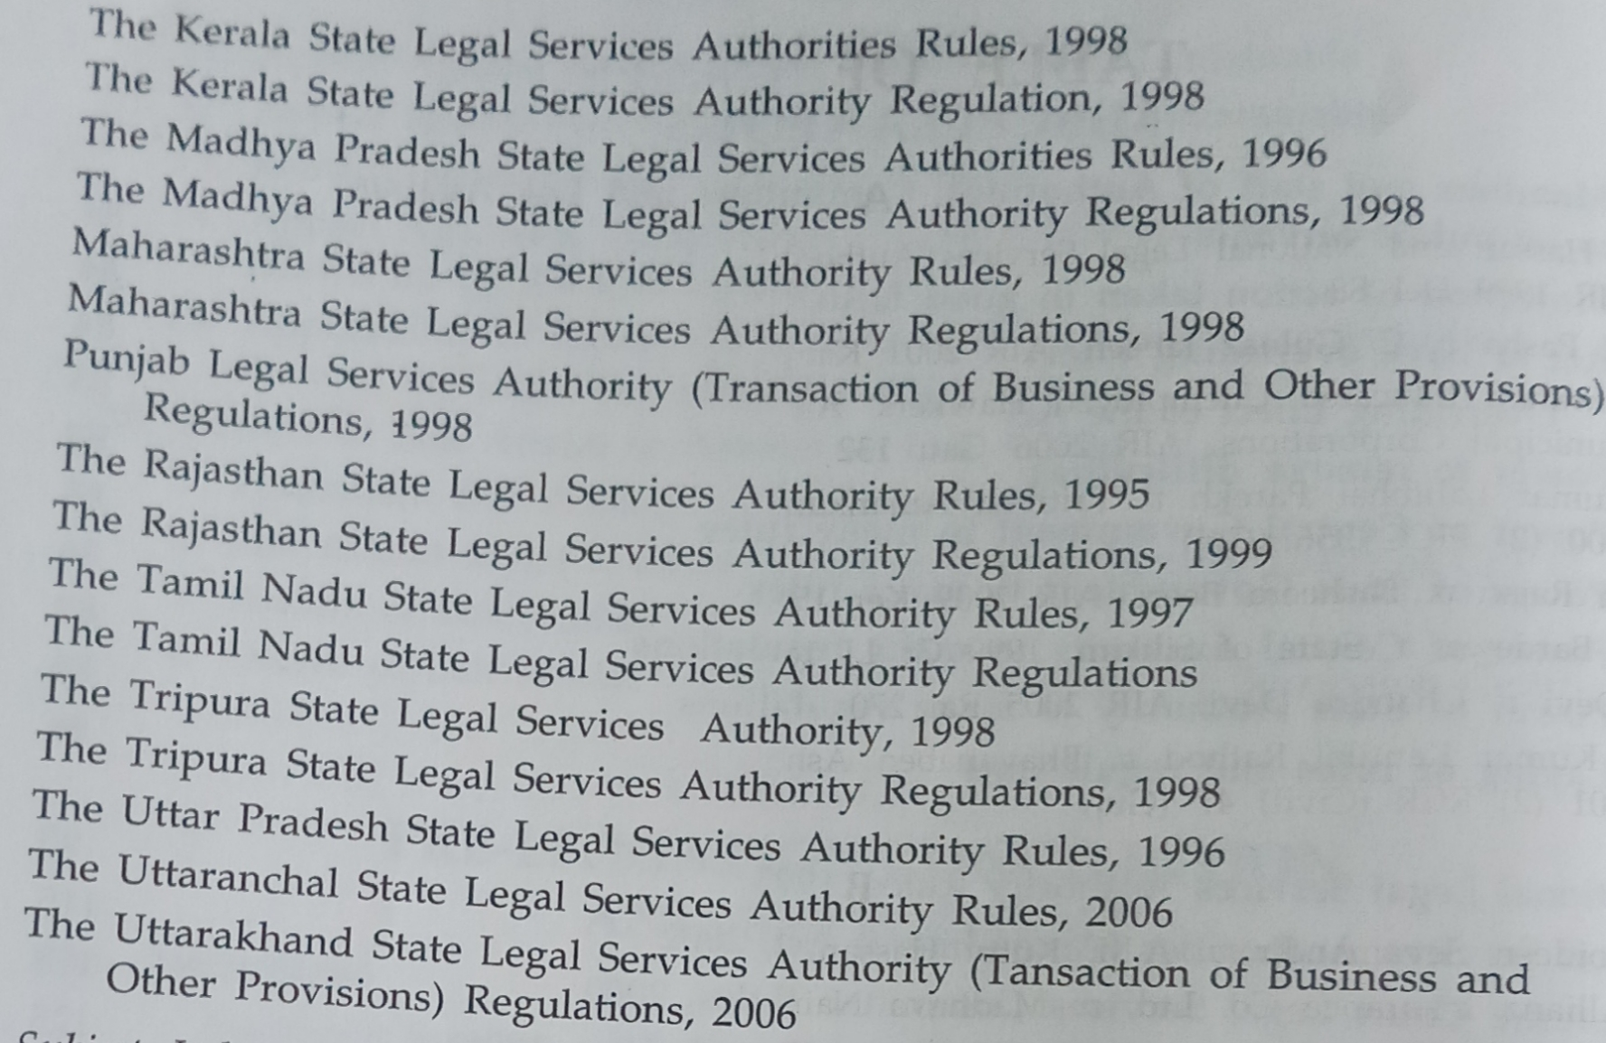

Slide 5
Outline
1. Legal Services Authorities Act, 1987
2. Other Rules & Regulations

Slide 6
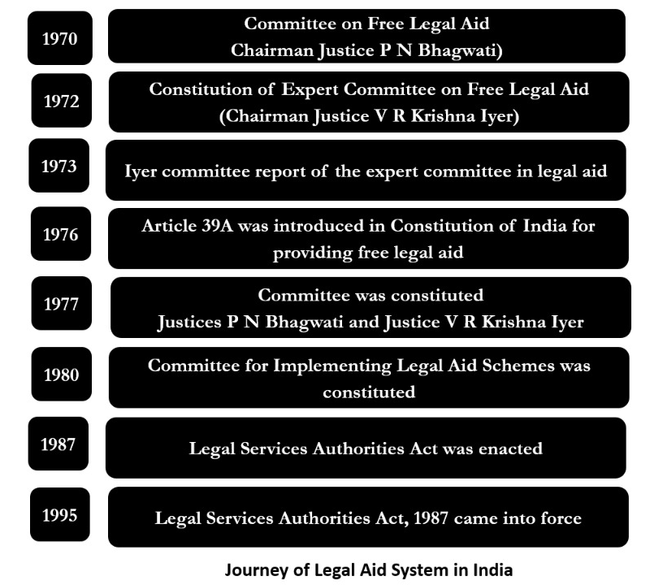

Slide 7
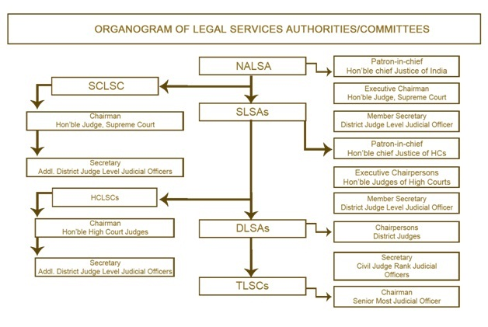

Slide 8
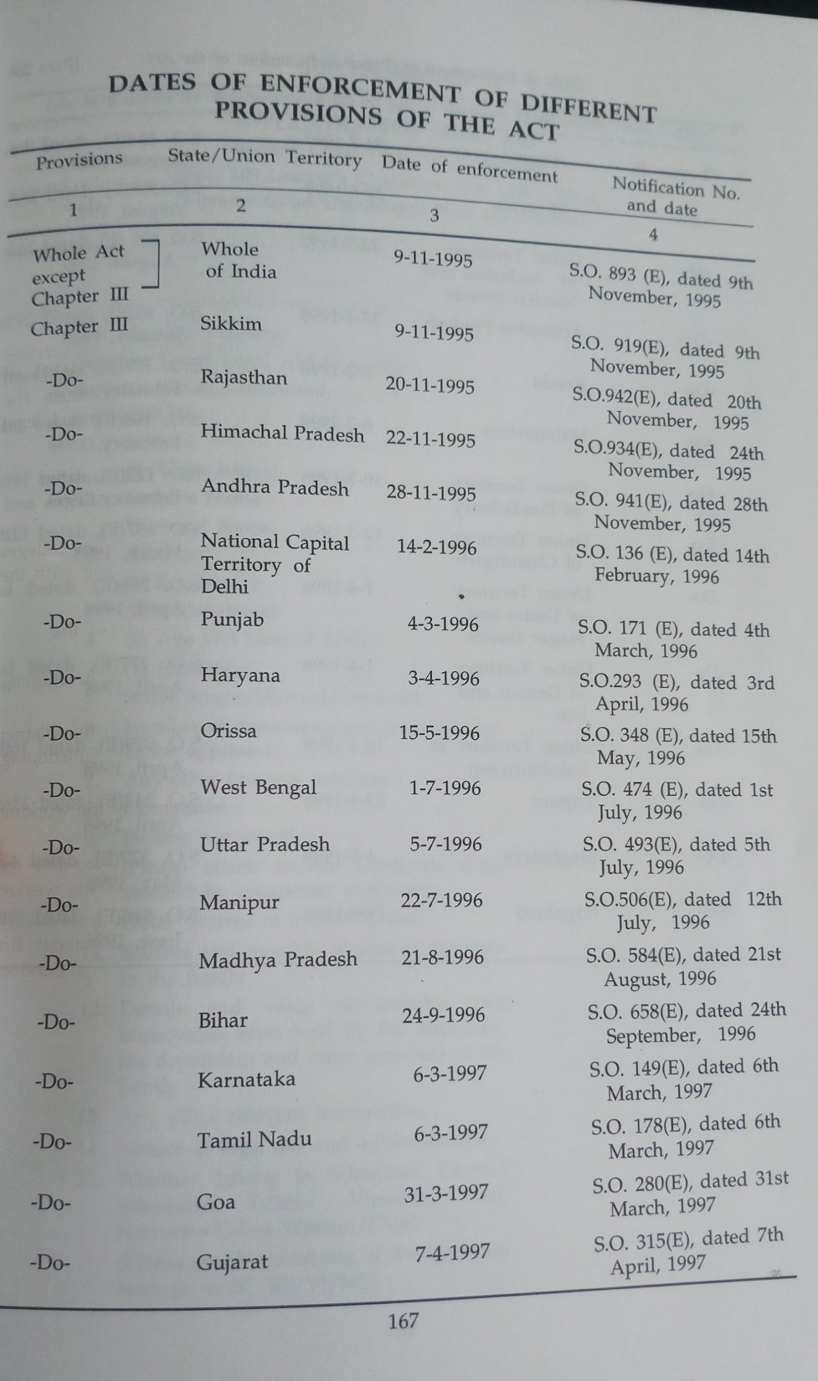

Slide 9
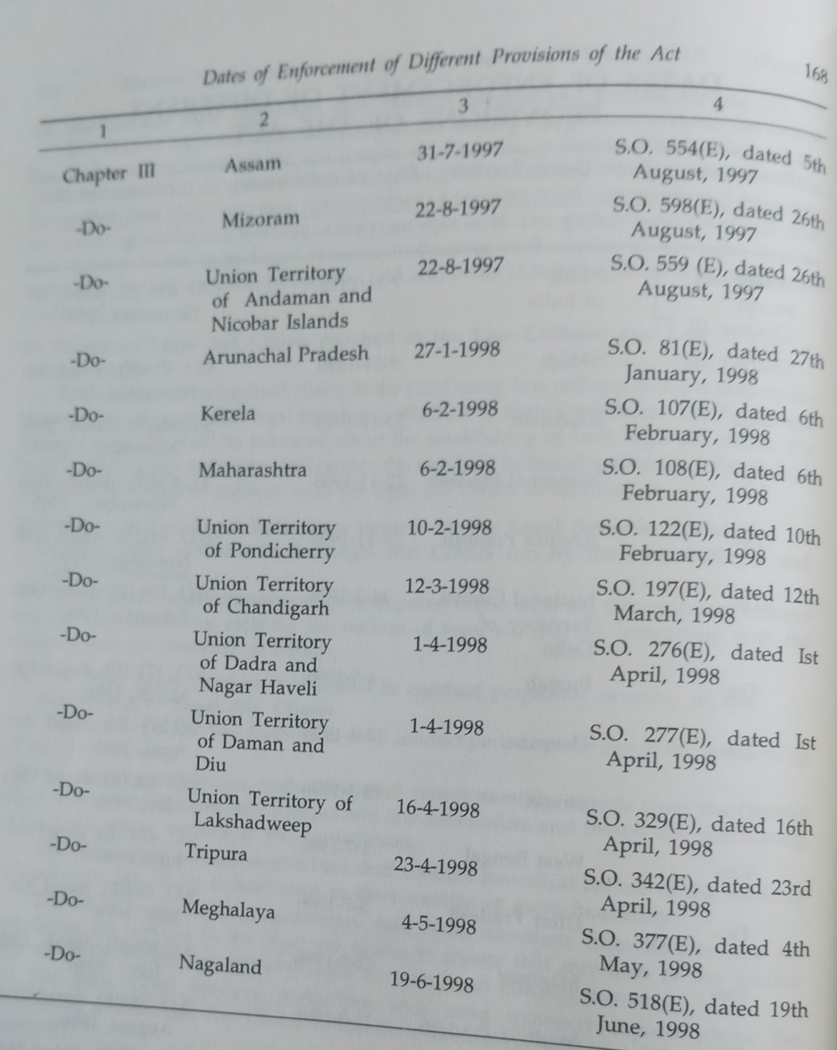

Slide 10
Legal Services Authorities Act, 1987
Section 3 – Constitution of National Legal Services Authority
Chief Justice of India shall be Patron-in-Chief
A serving or retired judge of SC will be Executive Chairman
Such other members
Member-Secretary
Other officers and employees

Slide 11
Legal Services Authorities Act, 1987
Section 4 – Functions of the Central Authority
Lay down policies and principles for making legal services available
Frame the most effective and economical schemes
Utilize the funds at its disposal and make appropriate allocations of funds to the State Authorities and District Authorities
Organize legal aid camps
Develop, in consultation with the Bar Council of India, programmes for clinical legal education and promote guidance and supervise the establishment and working of legal services clinics in universities, law colleges and other institutions.
Monitor and evaluate implementation of the legal aid programmes
Take appropriate measures for spreading legal literacy and legal awareness amongst the people. etc.

Slide 12
Legal Services Authorities Act, 1987
Section 6 – Constitution of State Legal Services Authority
The Chief Justice of High Court shall be the Patron-in-Chief
Serving or retired judge of the high court will be Executive Chairman
Such other members
Member-Secretary
Other officers and employees

Slide 13
Legal Services Authorities Act, 1987
Section 7 – Functions of the State Authority
It shall be the duty of the State Authority to give effect to the policy and directions of the Central Authority.
Without prejudice to the generality of the functions referred to in sub-section (1), the State Authority shall perform all or any of the following functions, namely:-
Give legal service to persons who satisfy the criteria laid down under this Act.
Conduct Lok Adalats, including Lok Adalats for High Court cases.
Undertake preventive and strategic legal aid programmes; and
Perform such other functions as the State Authority may, in consultation with the Central Authority, fix by regulations

Slide 14
Legal Services Authorities Act, 1987
Section 9 – District Legal Services Authorities
District judge will be its chairman
Other officers and employees
Member Secretary

Slide 15
Legal Services Authorities Act, 1987
Section 10 – Functions of District Authority
It shall be the duty of every District Authority to perform such of the functions of the State Authority in the District as may be delegated to it from time to time by the State Authority.
Without prejudice to the generality of the functions referred to in sub-section (1) the District Authority may perform all or any of the following functions, namely:-
Co-ordinate the activities of the Taluka Legal Services Committee and other legal services in the District.
Organise Lok Adalats within the Districts; and
Perform such other functions as the State Authority may fix by regulations.

Slide 16
Legal Services Authorities Act, 1987
Section 12 – Criteria for giving legal services
Every person who has to file or defend a case shall be entitled to legal services under this Act if that person is :-
(a) A member of a Scheduled Caste or Scheduled Tribe.
(b) A victim of trafficking in human beings or beggar as referred to in Article 23 of the Constitution.
(c) A woman or a child.
(d) A mentally ill or otherwise disabled person.
(e) A person under circumstances of undeserved want such as being a victim of a mass disaster, ethnic violence, caste atrocity, flood, drought, earthquake or industrial disaster or
(f) An industrial workman or
(g) In custody, including custody in a protective home within the meaning of clause (g) of Section 2 of the Immoral Traffic (Prevention) Act, 1956(104 of 1956); or in a juvenile home within the meaning of clause(j) of Section 2 of the Juvenile Justice Act, 1986 (53 of 1986); or in a psychiatric hospital or psychiatric nursing home within the meaning of clause (g) of Section 2 of the Mental Health Act, 1987(14 of 1987) or
Cont..

Slide 17
Cont..
Legal Services Authorities Act, 1987
Section 12 – Criteria for giving legal services
(h) In receipt of annual income less than Rs. 9,000 or such other higher amount as may be prescribed by the State Government, if the case is before a court other than the Supreme Court,
and less than Rs. 12,000 or such other higher amount as may be prescribed by the Central Government, if the case is before the Supreme Court.
….Annual income less than Rs. 5 Lakh (http://www.sclsc.nic.in/legal_services/100015)

Slide 18
Legal Services Authorities Act, 1987
Section 13 – Entitlement to legal services
(1) Persons who satisfy all or any of the criteria specified in Section 12 shall be entitled to receive legal services provided that the concerned Authority is satisfied that such person has a prima-facie case to prosecute or to defend.
(2) An affidavit made by a person as to his income may be regarded as sufficient for making him eligible to the entitlement of legal services under this Act unless the concerned Authority has reason to disbelieve such affidavit.

Slide 19
Legal Services Authorities Act, 1987
Section 15 – National Legal Aid Fund
Section 16 – State Legal Aid Fund
Section 17 – District Legal Aid Fund

Slide 20
Legal Services Authorities Act, 1987
Section 19 – Organization of Lok Adalats
Every State Authority or District Authority or the Supreme Court Legal Services Committee or every High Court Legal Services Committee or, as the case may be, Taluk Legal Services Committee may organise Lok Adalats at such intervals and places and for exercising such jurisdiction and for such areas as it thinks fit.

Slide 21
Legal Services Authorities Act, 1987
Section 20 – Cognizance of Lok Adalats
The parties thereof agree
or
one of the parties thereof makes an application to the court, for referring the case to the lok adalat for settlement and if such court is prima facie satisfied that there are chances of such settlement
or
the court is satisfied that the matter is an appropriate one to be taken cognizance of by the lok adalat, the court shall refer the case to the lok adalat: provided the no case shall be referred to the lok adalat by such court except after giving a reasonable opportunity of being heard to the parties

Slide 22
Legal Services Authorities Act, 1987
Section 21 – Award of Lok Adalat
Every award of the Lok Adalat shall be deemed to be a decree of a civil court or, as the case may be, an order of any other court and where a compromise or settlement has been arrived at, by a Lok Adalat in a case referred to under sub-section (1) of Section 20, the court-fee paid in such case shall be refunded in the manner provided under the Court Fees Act, 1870 (7 of 1870).
Every award made by a Lok Adalat shall be final and binding on all the parties to the dispute, and no appeal shall lie to any court against the award.

Slide 23
Legal Services Authorities Act, 1987
Section 22A – Definitions
In this chapter and for the purposes the Section 22 and 23, unless the context other requires.
(a) “Permanent Lok Adalat” means a Permanent Lok Adalat established under sub-section (1) of Section 22 B.
(b) “public utility service” means any –
(i) Transport services for the carriage of passengers or goods by air, road or water or
(ii) Postal telegraph or telegraph or telephone service or
(iii) Supply of power, light or water to the public by any establishment or
(iv) Postal telegraph or telegraph or telephone service or
(v) Service in hospital or dispensary or
(vi) Insurance service,
and includes any service which the Central Government or the State Government, as the case may be, may in the public interest, by notification, declare to be a public utility service for the purposes of this Chapter.

Slide 24
Legal Services Authorities Act, 1987
Section 22B – Establishment of Permanent Lok Adalat
Central Authority or, as the case may be, every State Authority shall, be notification, establish Permanent Lok Adalat at such places and for exercising such jurisdiction in respect of one or more public utility services and for such areas as may be specified in the notification.
A person who is, or has been, a district judge or additional district judge or has held judicial office higher in rank than that of a district judge, shall be the Chairman of the Permanent Lok Adalat and
2 other persons having adequate experience in public utility services to be nominated

Slide 25
Legal Services Authorities Act, 1987
Section 22C – Cognizance of Cases by Permanent Lok Adalat
Cases relating to Public Utility Services can be filed through an application on plain paper before the Chairman, Permanent Lok Adalat for Public Utility Services. The pecuniary jurisdiction of the Permanent Lok Adalat is Rs. 1 Crore.

Slide 26
Legal Services Authorities Act, 1987
Permanent Lok Adalat
No. of PLAs established | No. of PLAs functioning (as on 31.01.2016) | No. of sittings | No. of cases disposed of | Total settlement amount Rs.
292 | 239 | 17,117 | 1,03,559 | 23,87,00,291
Source :- https://nalsa.gov.in/content/permanent-lok-adalat

Slide 27
Outline
1. Legal Services Authorities Act, 1987
2. Other Rules & Regulations

Slide 28
National Legal Services Authority (Lok Adalat) Regulations, 2009

Slide 29
National Legal Services Authority (Lok Adalat) Regulations, 2009
Regulation 3 – Procedure for organizing Lok Adalats
Lok Adalats may be organized by the legal services authorities at regular intervals
Member Secretary may associate the members of the legal profession, college students, social organizations, charitable and philanthropic institutions and other similar organizations for organizing the Lok Adalats.
Regulation 4 – Intimation to the state authority
Legal Services Authorities shall inform State Authority about the proposal to organize the Lok Adalat well before the date
Details..Date Place, Category, nature of cases, any other informations

Slide 30
National Legal Services Authority (Lok Adalat) Regulations, 2009
Regulation 5 – Notice to parties concerned
Member Secretary shall inform every party concerned whose case is referred to the adalat, well in time.
Regulation 6 – Composition of Lok Adalat
At state authority level, At High Court level, At District level, At Taluka level
Serving or retired judicial officer and plus any one or two of the following
A member of the legal profession
A social worker
A professional from the field related to the subject matter (Inst. Oct. 18)
A mediator or a professional or a serving or retired sr. executive (Inst. Oct. 18)

Slide 31
National Legal Services Authority (Lok Adalat) Regulations, 2009
Regulation 7 – Allotment of cases to Lok Adalats
Member Secretary shall assign specific cases to each bench of the lok adalat
Every bench of the Lok Adalat shall make sincere efforts to bring about a conciliated settlement in every case put before it without bringing about any kind of coercion, threat, undue influence, allurement or misrepresentation.
Regulation 9 – Jurisdiction of Lok Adalats
Lok Adalats shall have the power only to help the parties to arrive at a compromise or settlement between the parties to a dispute and, while so doing, it shall not issue any direction or order in respect of such dispute between the parties.

Slide 32
National Legal Services Authority (Lok Adalat) Regulations, 2009
Regulation 10 – Reference of cases and matters
Lok Adalat shall get jurisdiction to deal with a case only when a court of competent jurisdiction orders the case to be referred in the manner prescribed
A pre-litigation matter may be referred to the Lok Adalat by the concerned Legal Services Institution on the request of any of the parties after giving a reasonable opportunity of being heard to the other party (Inst. Oct 2018)
Regulation 13 – Procedure in Lok Adalats
Members of Lok Adalat have the role of statutory conciliators only and have no judicial role

Slide 33
National Legal Services Authority (Lok Adalat) Regulations, 2009
Regulation 17 – Award
Drawing up of the award is merely an administrative act by incorporating the terms of settlement or compromise agreed by parties under the guidance and assistance from Lok Adalat.
When both parties sign or affix their thumb impression and the members of the Lok Adalat countersign it, it becomes an award (see a specimen at Appendix-I)
Regulation 19 – Failure of Lok Adalat proceedings
If a pre-litigation matter is not settled in the Lok Adalat, the parties may be advised to resort to other Alternative Dispute Resolution (ADR) techniques or to approach a court of law and in appropriate cases they may be advised about the availability of legal aid.

Slide 34
National Legal Services Authority (Lok Adalat) Regulations, 2009
Regulation 23 – Appearance of lawyers and the procedure to be followed in the cases before Lok Adalats
The appearance of lawyers on behalf of the parties at the Lok Adalat shall not be barred and an effort shall be made to encourage the parties to be present personally. The lawyers may be advised to avoid wearing their robes and bands during the proceedings before the Lok Adalat.

Slide 36
National Legal Services Authority (Free & Competent Legal Services) Regulation, 2009

Slide 37
National Legal Services Authority (Free & Competent Legal Services) Regulation, 2009
Regulation 3 – Application for Legal Services
Application to be made in Form I in the local language or English
An applicant advised by the para-legal volunteers, legal aid clubs, legal aid clinics and voluntary social service institutions shall also be considered for free legal services.
Requests received through e-mails and interactive on-line facility also may be considered for free legal services after verification of the identity of the applicant and on ensuring that he or she owns the authorship of the grievances projected
Regulation 4 – Legal Services Institutions to have a front office
LSI shall have a front office to be manned by a retainer lawyer on rotational basis and one or more para-legal volunteers available during office hours

Slide 39
National Legal Services Authority (Free & Competent Legal Services) Regulation, 2009
Regulation 5 – Proof of entitlement of free legal services
A self-certificate of the applicant, along with self-attested copy of relevant documents or certificates, if any, that he falls under the categories of persons entitled to free legal services under Section 12 of the Act shall ordinarily be sufficient
Application will be scrutinized by member secretary or person assigned (Reg. 7)

Slide 40
National Legal Services Authority (Free & Competent Legal Services) Regulation, 2009
Regulation 8 – Panel Lawyers
Application are invited by legal services authority
Min. 3 years experience at a Bar
Preparation of list of panel lawyers to be designated as Retainers
Strength of Retainers in SC 20, HCs 15, Dist. 10, Taluka 5
Honorarium to the retainer SC 40K pm, State 25K pm, Dist. 15K pm, Taluka 10K pm
Regulation 10 – Monitoring & Mentoring Committee
Committee to be set up
Bi-monthly report to be prepared

Slide 41
National Legal Services Authority (Free & Competent Legal Services) Regulation, 2009
Regulation 14 – Payment of fees to the panel lawyers
Panel lawyers shall be paid fee in accordance with the Schedule of fee, as approved under the State regulations.
The State Legal Services Authority and other Legal Services Institution shall effect periodic revision of the honorarium to be paid to panel lawyers for the different types of services rendered by them in legal aid cases.
As soon as the report of completion of the proceedings is received from the panel lawyer, the Legal Services Institution shall, without any delay, pay the honorarium.

Slide 42
National Legal Services Authority (Legal Services Clinics) Regulations, 2011

Slide 43
National Legal Services Authority (Legal Services Clinics) Regulations, 2011
Regulation 2(1)(c) – Legal Services Clinic
…means the facility established by the District Legal Services Authority to provide basic legal services to the people with the assistance of para-legal volunteers or lawyers, as the point of first contact for help and advice and
…includes legal services clinics set up under Regulation 3 (village, jail, education insts, community centers, protection homes, courts etc.) and Regulation 24 (law colleges, law universities and other institutions)

Slide 44
National Legal Services Authority (Legal Services Clinics) Regulations, 2011
Regulation 3 – Establishment of LSC
Subject to the financial resources available, the District Legal Services Authority shall establish legal services clinics
Regulation 4 – Eligibility criteria for free legal services in the LSC
Every person who fulfills the criteria specified in section 12 shall be eligible to get free legal services

Slide 45
National Legal Services Authority (Legal Services Clinics) Regulations, 2011
Regulation 5 – The personnel manning the LSC
At least 2 para-legal volunteers available during working hours
Duty of PLV to assist the lawyers in drafting petitions, applications, pleadings and other legal documents
Regulation 6 – Deputing lawyers to the LSC
Panel Lawyers or retainers lawyers
Frequency of lawyers as per regulation 7
The penal lawyers or retainer lawyers with skills for amicable settlement of disputes shall alone be considered for being deputed. (Regulation 8)

Slide 46
National Legal Services Authority (Legal Services Clinics) Regulations, 2011
Regulation 9 – Legal Services in the LSC
Wide range of services
Single window facility for helping the disadvantaged people to solve their legal problems whenever needed
Solving problems with govt. offices
Initial legal advise on problem
Regulation 10 – Functions of PLVs in the LSC
Provide initial advice person seeking legal services, accompany the persons seeking legal services to attend govt. offices, if service of lawyer is required then approach nearest legal services institutions, legal awareness etc.,

Slide 47
National Legal Services Authority (Legal Services Clinics) Regulations, 2011
Regulation 11 – Location of LSC
Shall be located at places where people of the locality can have easy access
The LSC may request local body institutions, such as the village panchayat to provide a room for establishing LSC
If rooms are not available DLSA may take a room on rent till alternate accommodation is available for establishing the LSC
Regulation 13 – Signboard exhibiting name of LSC
Signboard both in English and in the local language

Slide 48
National Legal Services Authority (Legal Services Clinics) Regulations, 2011
Regulation 16 – Resolve dispute amicable
PLV or lawyer shall attempt to amicable resolve the pre-litigation dispute brought to the LSC
Regulation 17 – Honorarium
Lawyer Rs. 500 per day, PLV Rs. 250 per day
Special consideration may be given in cases where the LSC is situated in difficult terrains and in distant places where transport facility are inadequate
Regulation 20 – Maintenance of records and register
Records to be maintained in register

Slide 49
National Legal Services Authority (Legal Services Clinics) Regulations, 2011
Regulation 22 – LSC run by the law students
All regulations shall mutatis mutandis be applicable to the student LSC set up by the law colleges and universities
Regulation 23 – Law students may adopt a village for legal aid campus
Law students may adopt a village, esp. in the rural area for legal awareness and aid

Slide 50
National Legal Services Authority (Legal Services Clinics) Regulations, 2011
Regulation 24 – LSC attached to the law colleges, law universities and other institutions
The law colleges, law universities and other institutions may set up LSC as envisaged in clause (k) of Section 4 attached to their institutions as a part of the clinical legal education
The law students in the final year classes may render legal services in such LSC under the supervision of the faculty member of their institutions
DLSA may issue certificates to the students who complete their assignments in such LSC
Regulation 25 – Service of PLVs
Trained PLVs may be deputed to the LSC established under Regulation 24 for assisting the persons seeking free legal services and for interacting with the students and the members of the faculty.

